Slide 1
Chapter 9
Motivation

Slide 2
Organizational psychology
Organizational psychology: the study of dispositional and situational variables that affect workers

Slide 3
Motivation
Motivation: the cause of behavior

Slide 4

Instinct Theory
Instinct: Inborn pattern of behavior
  Seen in almost all members of a species

Slide 5
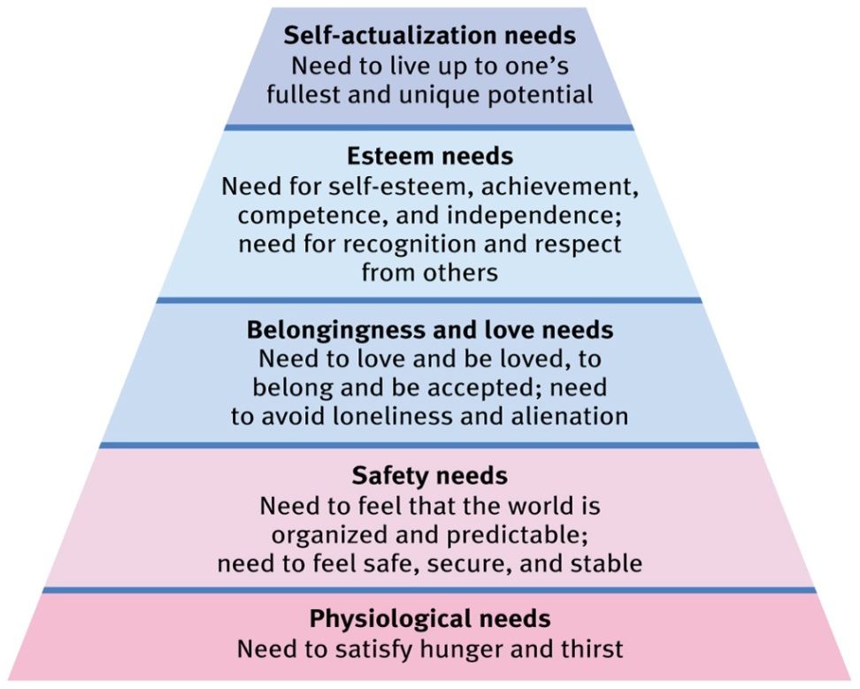
Need Theory
Need/Drive: internal universal motivation
Hierarchy of Needs: lowest levels must be satisfied first

Slide 6
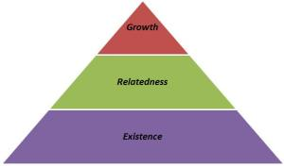
Need Theory
Alderfer’s ERG theory: people strive to meet 3 kinds of needs simultaneously
  Frustration-regression: inability to meet a higher level need may shift focus to a lower need

Slide 7
2-Factor Theory
Herzberg’s 2-factor theory: different aspects of the job lead to satisfaction and dissatisfaction; they are not opposite ends of the same spectrum

Slide 8


Job Characteristics Theory
Job Characteristics:
  Skill variety: different tasks
  Task identity: completing a product from beginning to end
  Task significance: has a substantial impact on others
  Autonomy: independence
  Feedback: information about how well an employee is performing the job

Slide 9
Job Characteristics Theory
Growth need strength: extent to which higher order needs are important to an individual
  Higher growth need strength causes job characteristics to have more of a motivating influence

Slide 10

Self-determination Theory
Intrinsic motivation: from within
  Events, such as recognition, that make a person feel competent lead to intrinsic motivation
Extrinsic: from without

Slide 11
Self-determination Theory
Overjustification effect: in some situations, adding extrinsic motivation to a task that is already intrinsically motivating can lead individuals to be less motivated

Slide 12
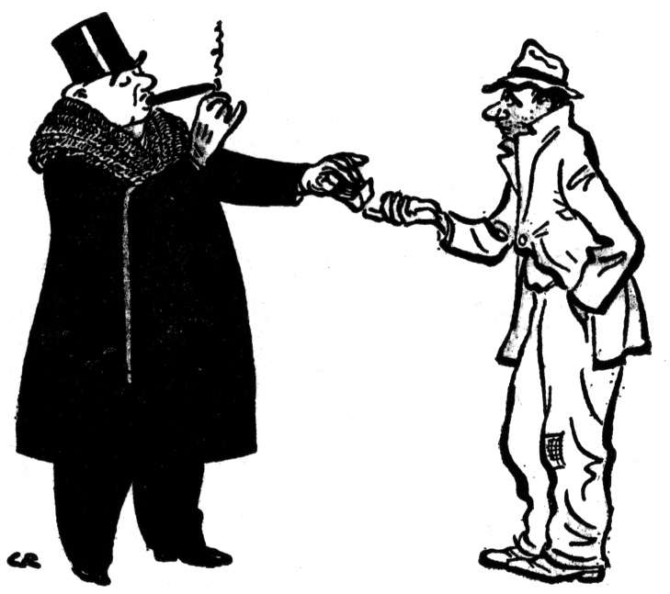
Equity Theory
Equity theory: people compare their ratio of inputs/outcomes to relevant others
Equity sensitivity: individual differences in the extent to which people are affected by inequity

Slide 13
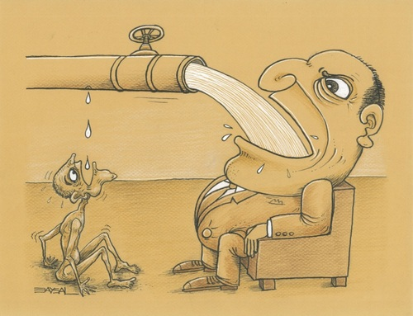
Equity Theory
Organizational justice: perceptions of fairness within an organization

Slide 14
Justice
Justice
  Distributive: allocation of resources
    Merit/equity based
    Need based
    Equality
  Procedural: process
  Interpersonal/Interactional: respectful communication

Slide 15
Expectancy Theory
Expectancy theory
  Expectancy: effort leads to performance (self-efficacy/locus of control)
  Instrumentality: performance leads to outcomes
  Valence: outcomes are valued

Slide 16
Goal-setting Theory
Self-regulation: monitoring one’s own behavior and making adjustments in the pursuit of goals
Goal-setting Theory: When individuals are committed to specific difficult goals, these goals…
  Direct attention
  Focus effort
  Lead to persistence
  Help facilitate strategies for performance

Slide 17
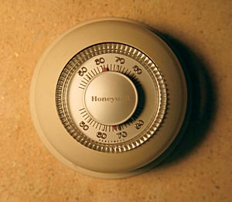
Control Theory
Control theory: Behavior is altered until outcome is in line with a standard
  Feedback loop
  Self-regulation
  We have the ability to abandon or change goals

Slide 18

Theory of Behaviorism
Operant conditioning: reinforcement and punishment

Slide 19
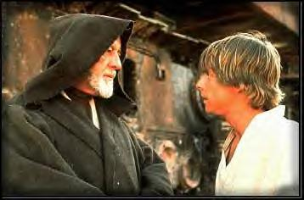
Field Theory
Field Theory: various forces push people towards or away from different behaviors

Slide 20
Differences in Motivation
Motivation can differ by
  Personality
  Culture
  Age/Cohort

Slide 21
Applications
Organizational Behavior Management: using operant conditioning to influence the behavior of employees
Management by Objectives:
  Participative goals set
  Develop an action plan
  Performance review
  New participative goals are set

Slide 22
Applications
Job Enrichment: increasing motivation by improving job characteristics

